Slide 1
Image classification on CNN and dimension reduction
By Will Sherrer and Ashton Sobeck

Slide 2
What is a CNN
CNN stands for Convolutional Neural Network. They were inspired by the biological processes in that neuron connectivity leads to outcomes in animal visual cortexes.
It is primarily used for image classification. It involves lower pre-processing than other image classifiers and it learns to optimize its filters through automated learning.
A major advantage is this independence from prior knowledge and human intervention in feature extraction.

Slide 3


How does a CNN work
A CNN works by developing filters and feature maps to recognize patterns in images.
Different filters recognize different features in an image.
Then it passes it to a fully connected network which generates the probabilities of a certain output.

Slide 4
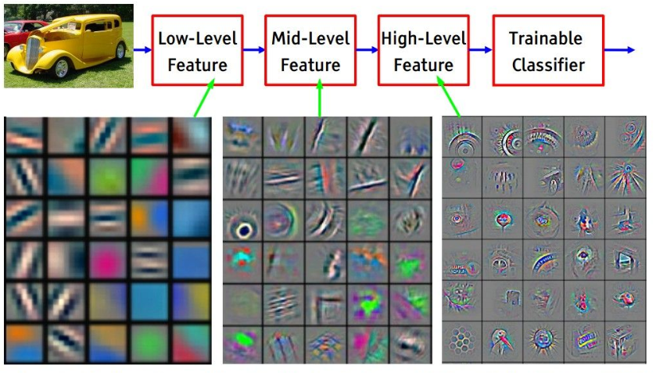
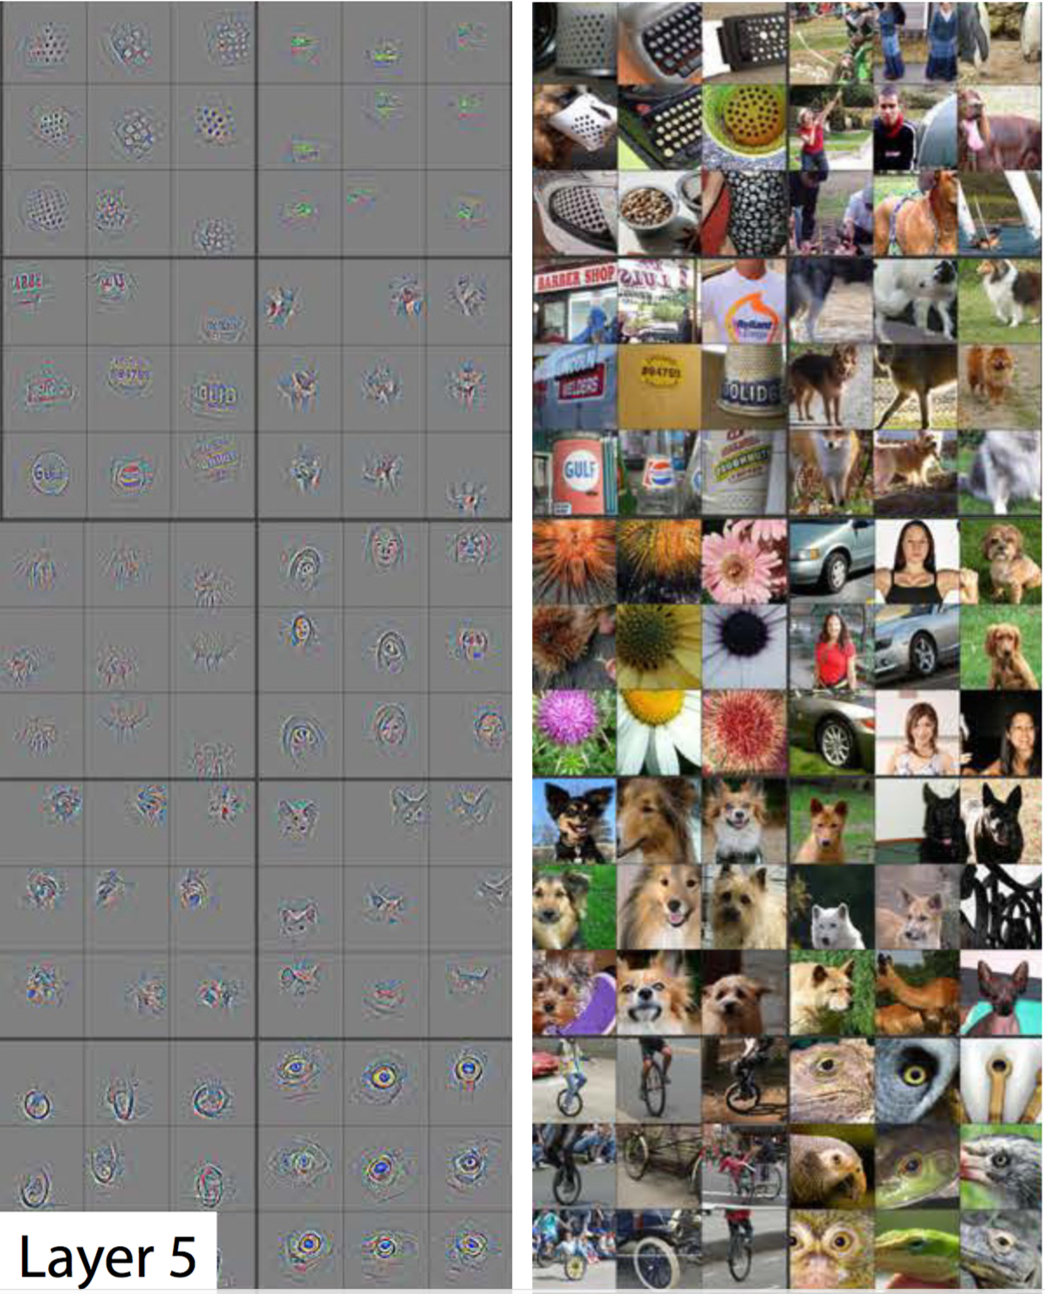
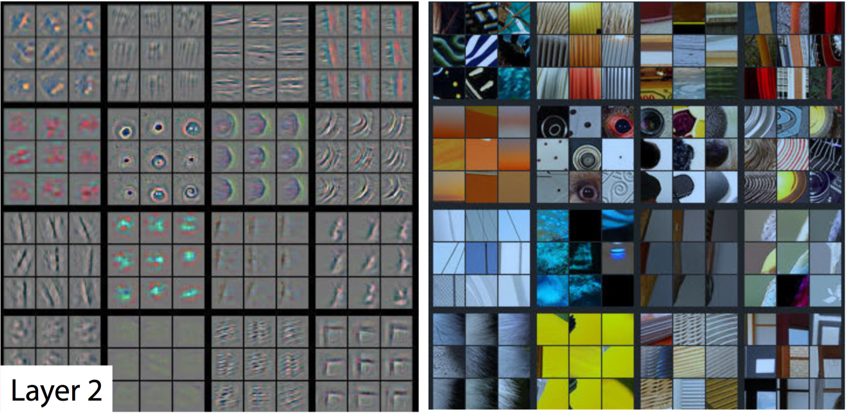

Slide 5
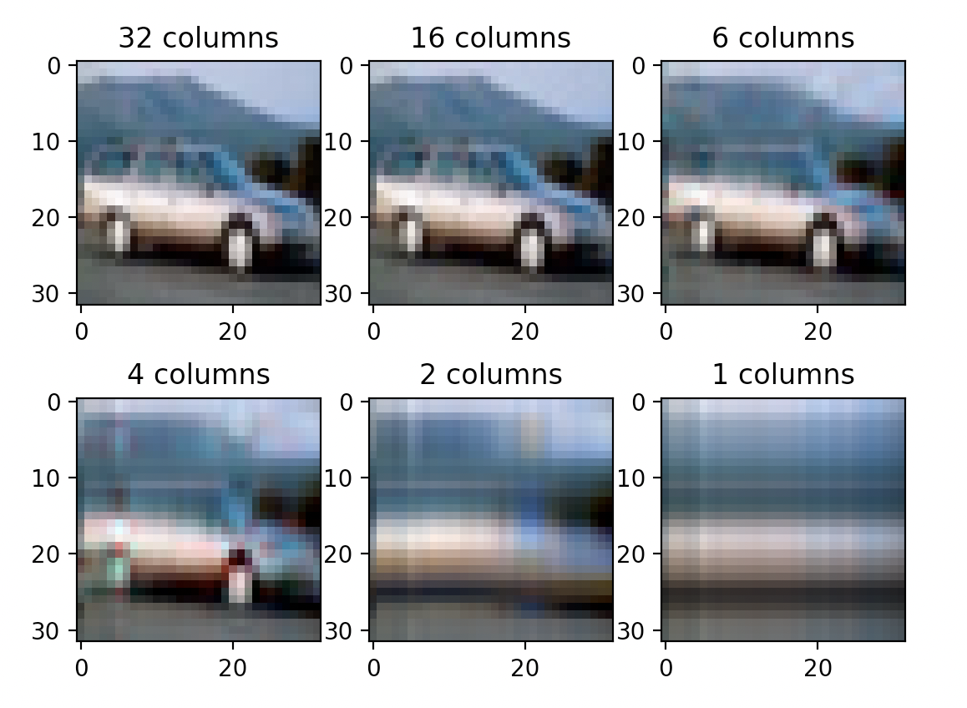
Our topic question
At what point can CNNs learn from Reduced Images.
We used SVD to perform PCA on the CIFAR-10 dataset.
If a CNN can learn from reduced images, then we can expand datasets to be larger without sacrificing performance.

Slide 6
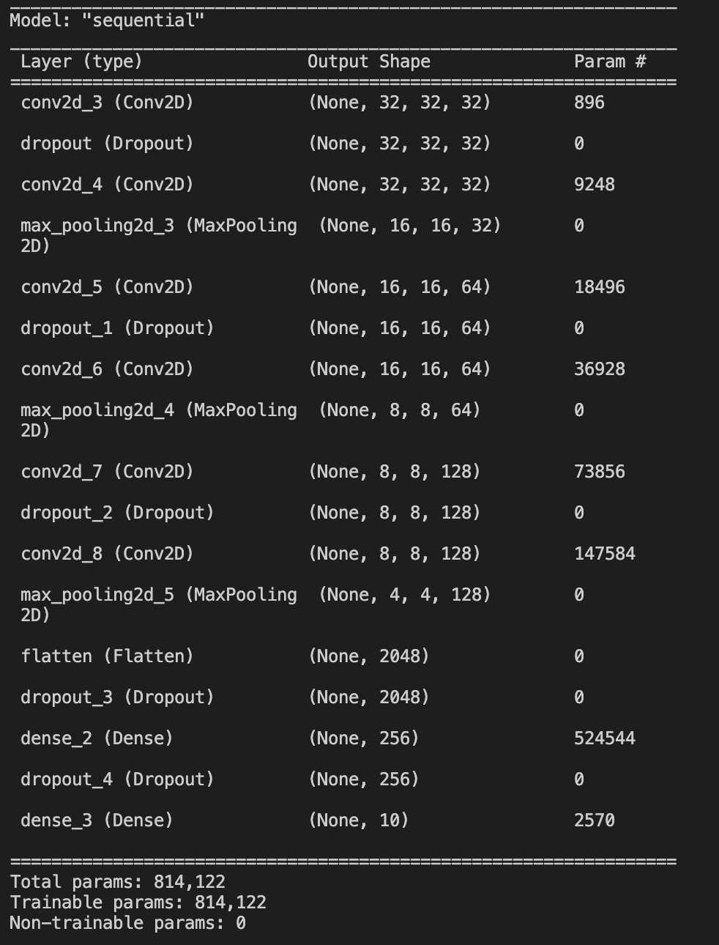
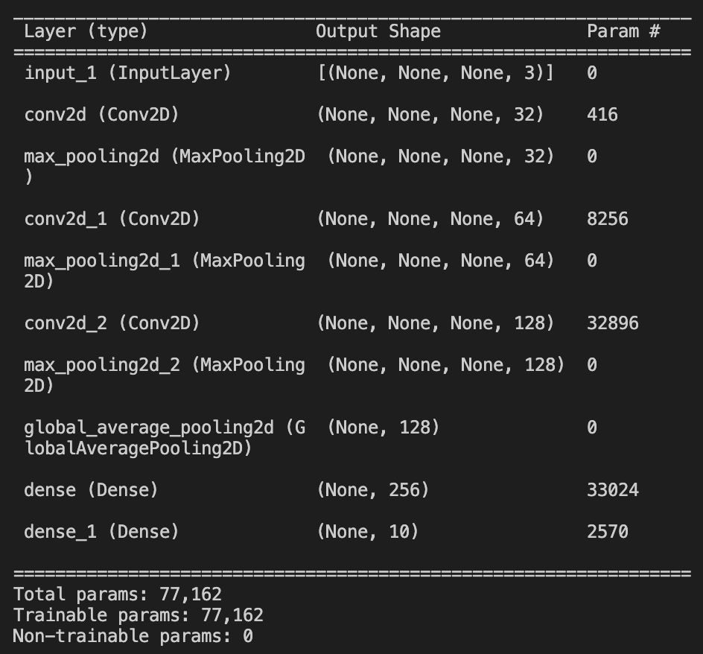
Training with 2 models

Slide 7
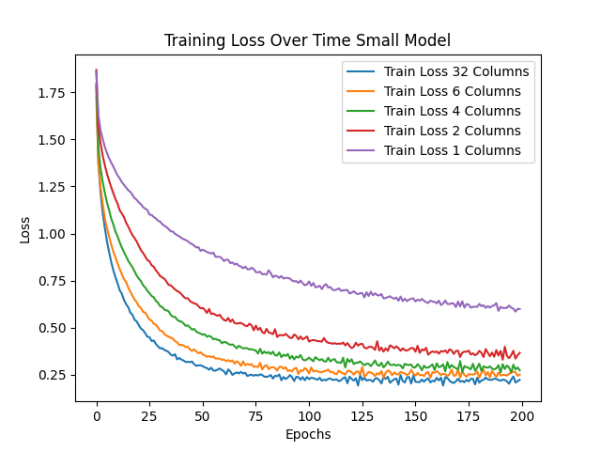
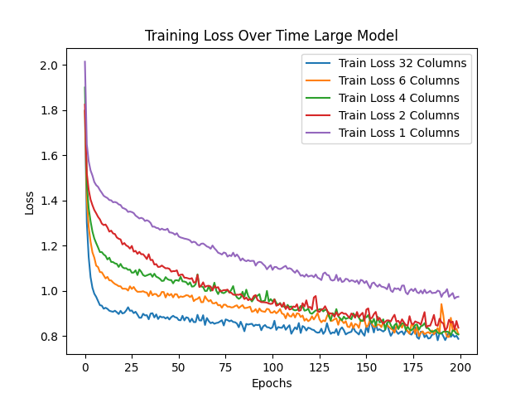
LOSS OVER TIME training

Slide 8
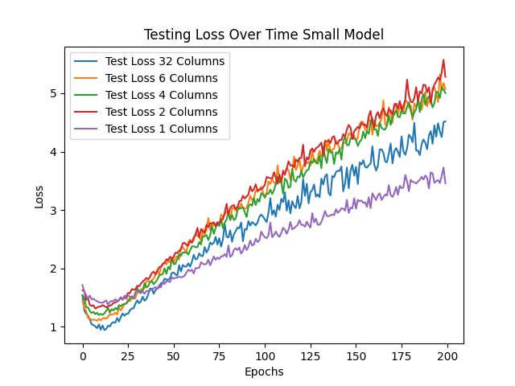
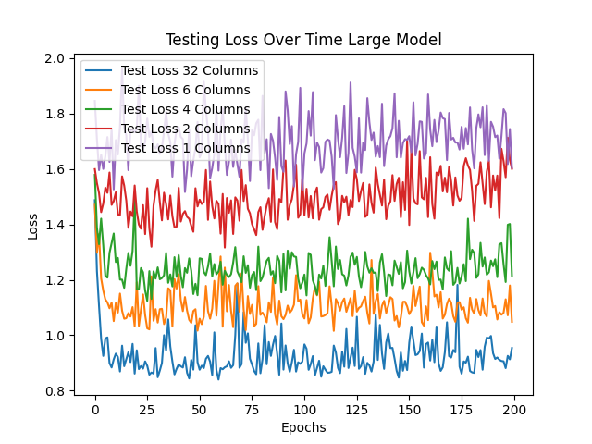
Loss over time testing

Slide 9
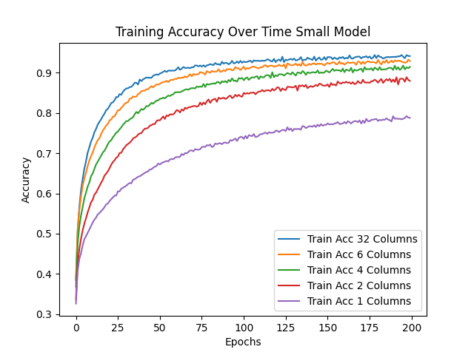
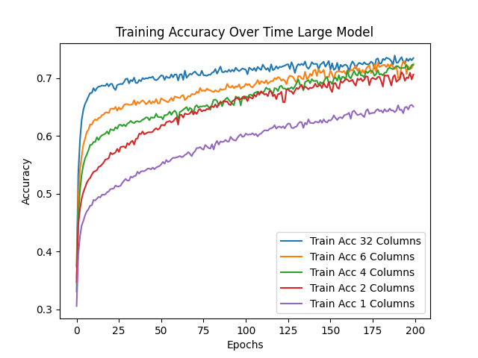
Training Accuracy over time

Slide 10
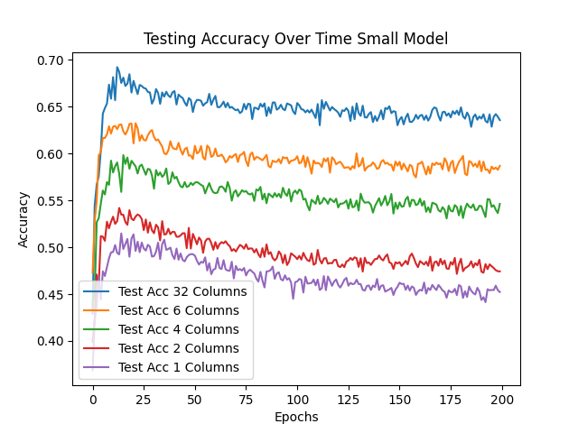
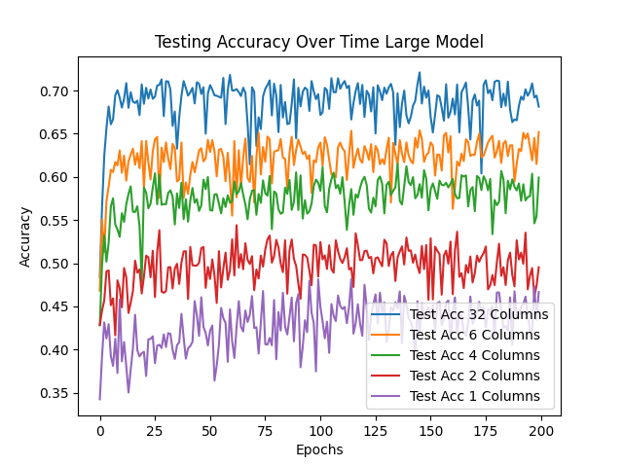
Testing Accuracy over time

Slide 11
Conclusion
We see that it is possible to train a CNN with a dimensionally reduced dataset.
The smaller model overfitting shows that reducing a dataset does not decrease the chance of overfitting the dataset.
Having a larger model might be required to use dimensionally reduced datasets.
With other datasets, the number of features to reduce to will be dependent on the data itself.
No “gold standard” feature number can be determined.

Slide 12
References
https://medium.com/@chriskevin_80184/feature-maps-ee8e11a71f9e
https://www.analyticsvidhya.com/blog/2021/05/20-questions-to-test-your-skills-on-cnn-convolutional-neural-networks/
https://notebook.community/nehal96/Deep-Learning-ND-Exercises/Convolutional%20Neural%20Networks/convolutional-neural-networks-notes
https://arxiv.org/pdf/1901.03924.pdf

